Slide 1

“l think it’s fair to say that personal computers have become the most empowering tool we’ve ever created. They’re tools of communication ,they’re tools of creativity, and they can be shaped by their user.” ---------------------Bill gates

Slide 2
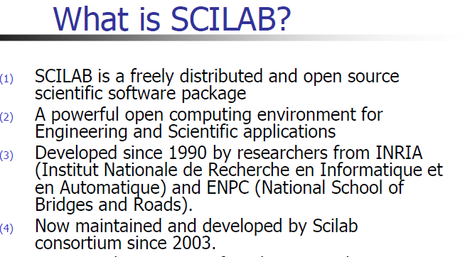

Slide 3
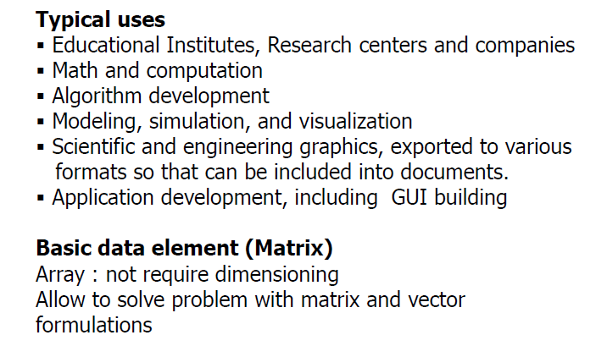

Slide 4
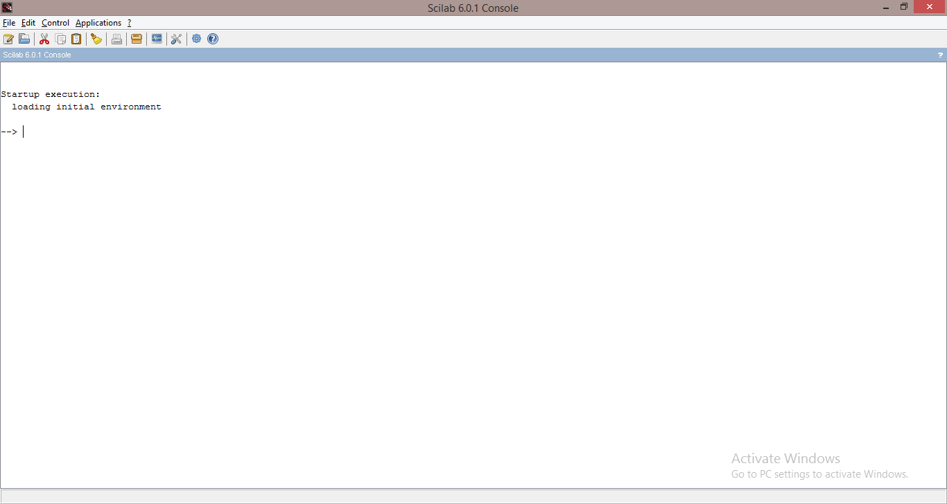

Slide 5
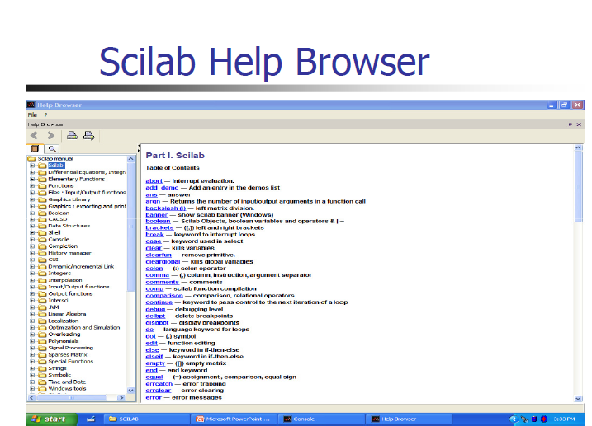

Slide 6
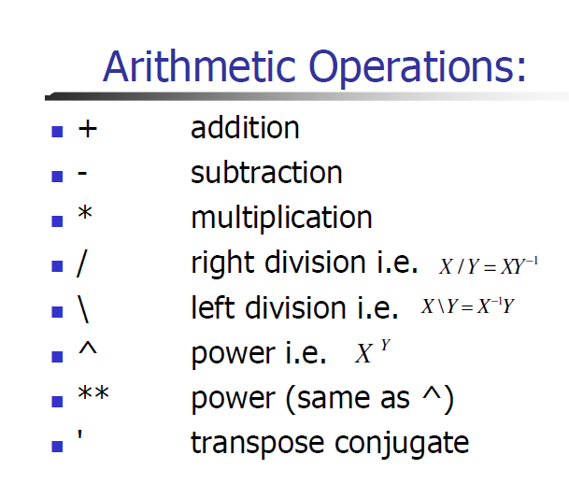
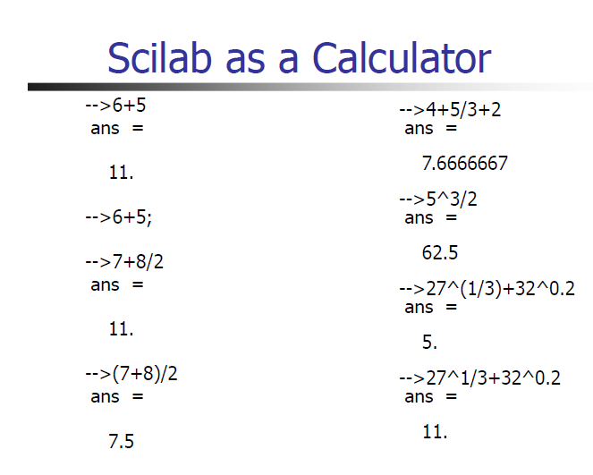

Slide 7

LETS TALK ABOUT THE PROJECT
Plotting graphs ,Loops ,iterations and Relational operators in SCILAB

Slide 8
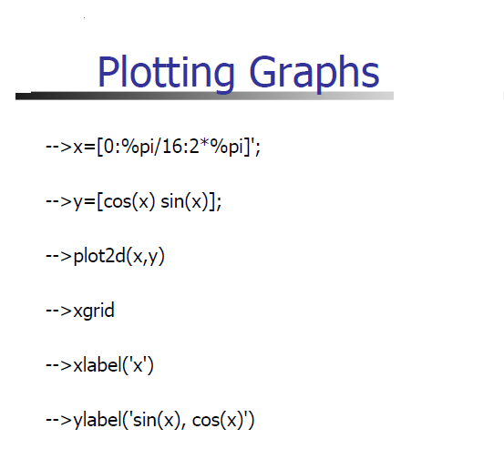

Slide 9
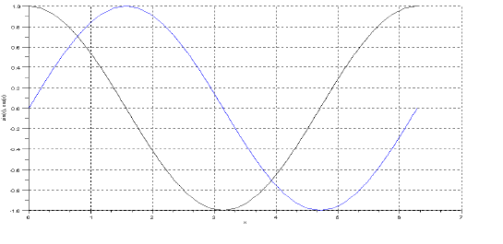

Slide 10
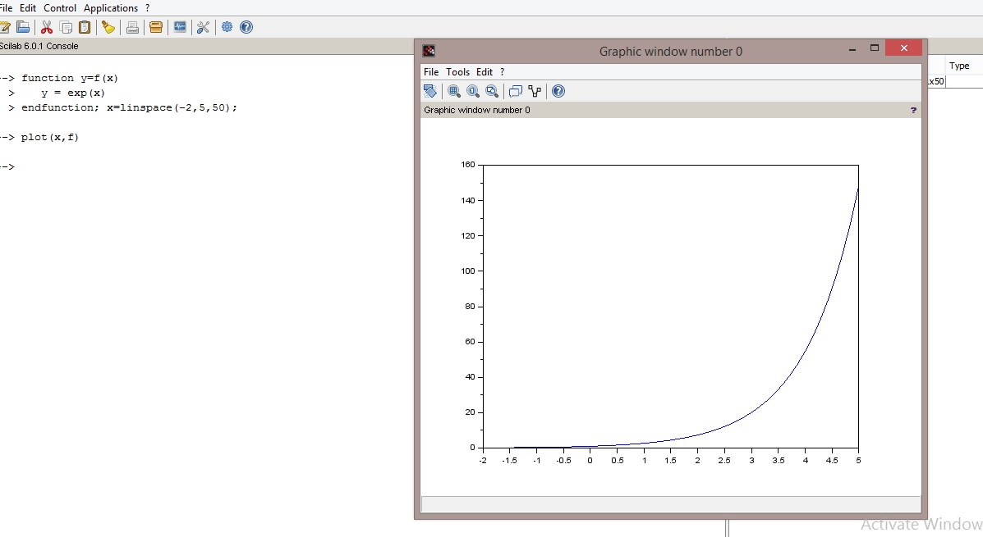

Slide 11
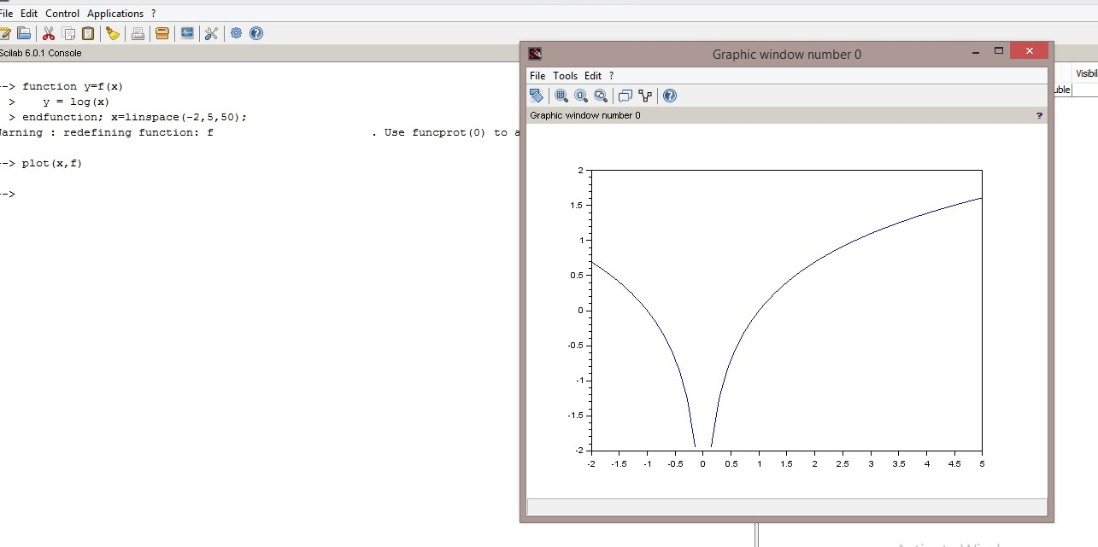

Slide 12
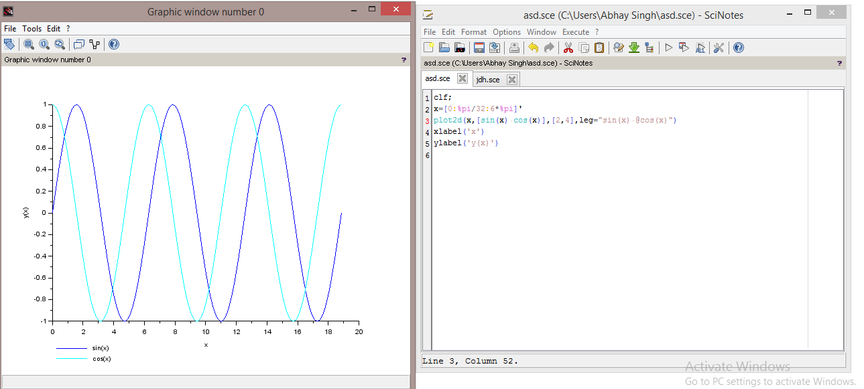

Slide 13
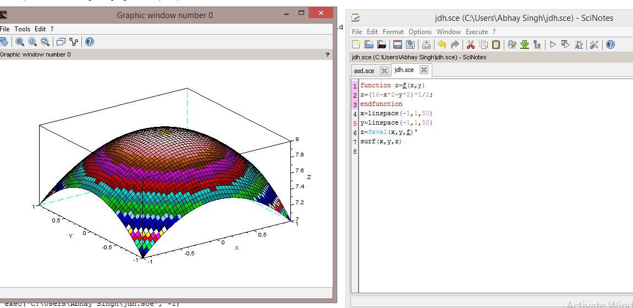

Slide 14
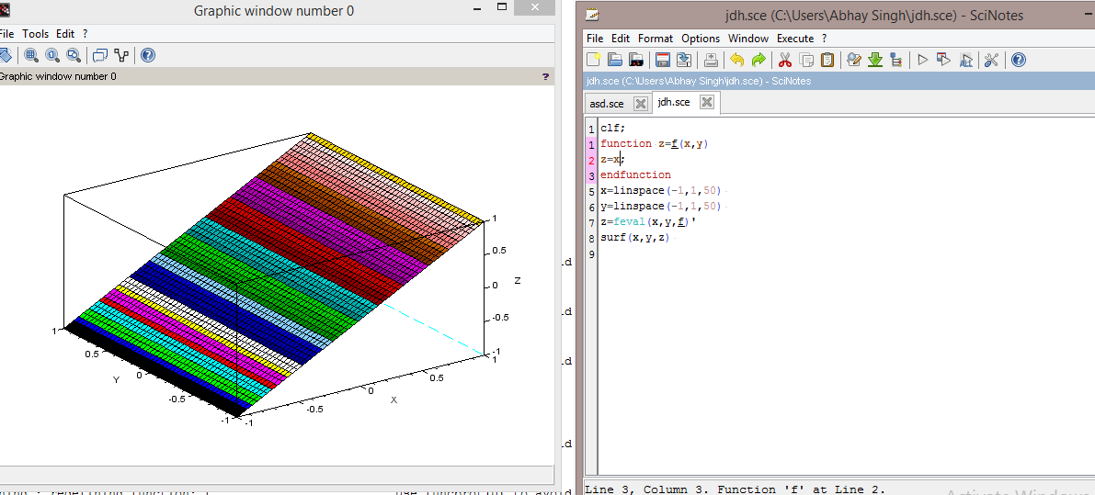

Slide 15
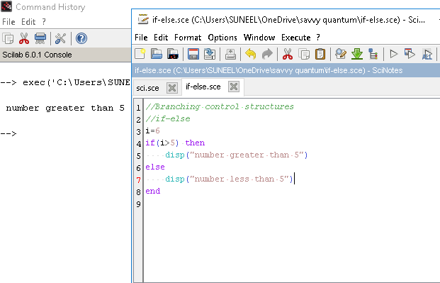
IF ELSE

Slide 16
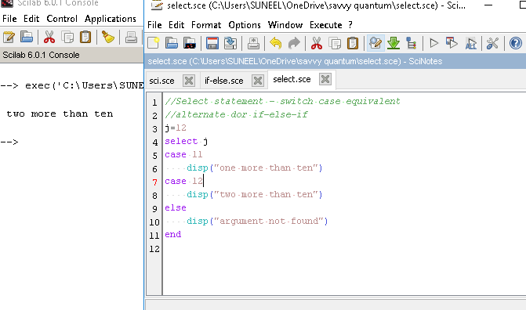
Select Statement

Slide 17
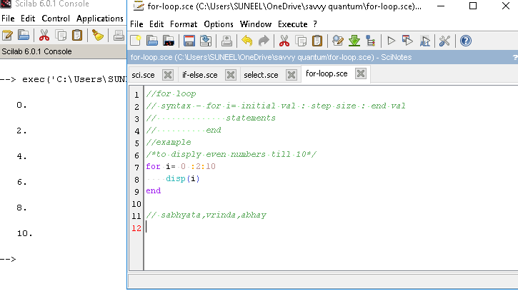
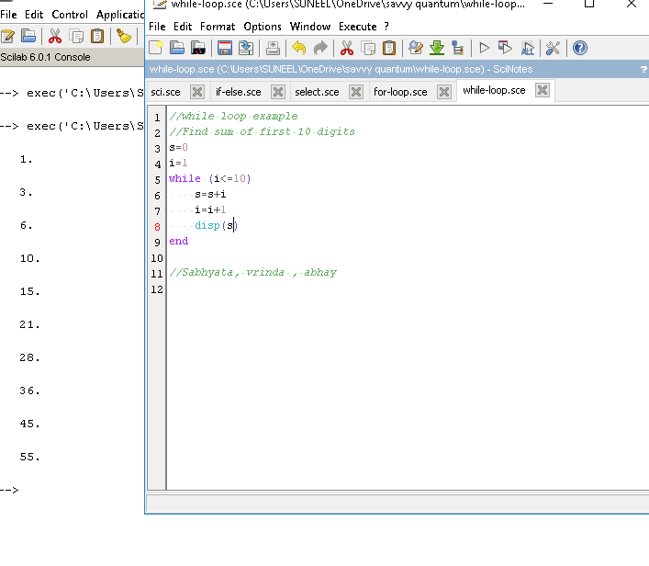
For and while loops

Slide 18
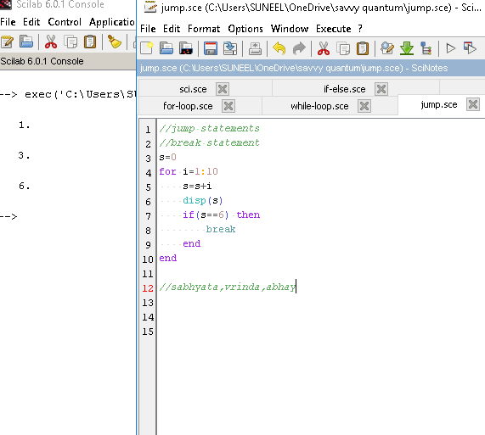
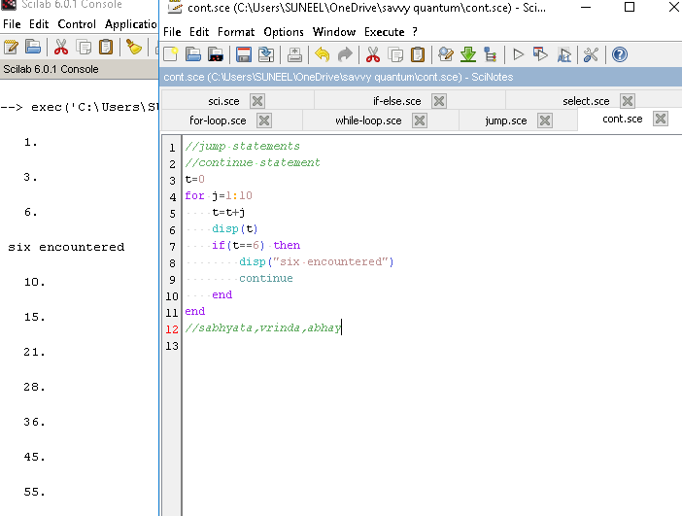
BREAK AND CONTINUE

Slide 19
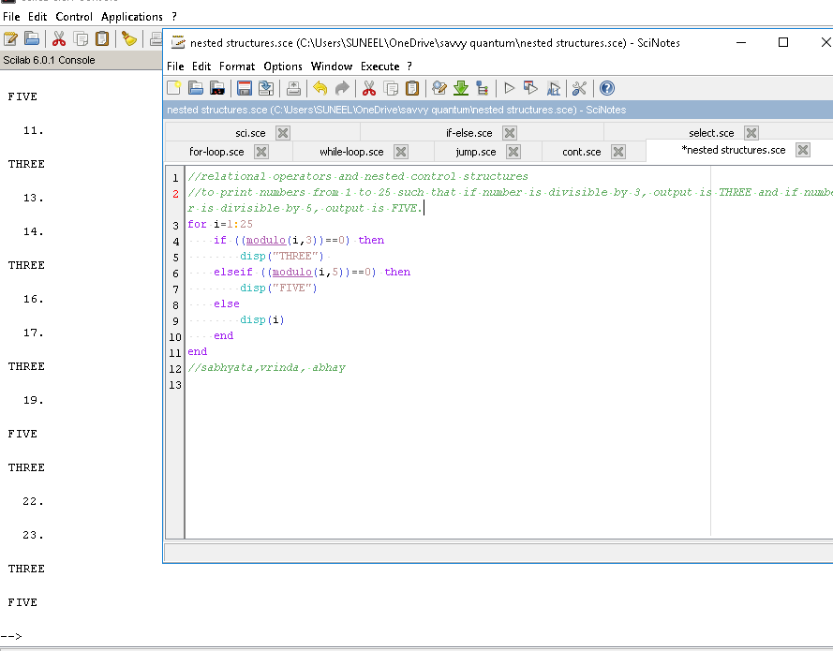
NESTED CONTROL STRUCTURE

Slide 20
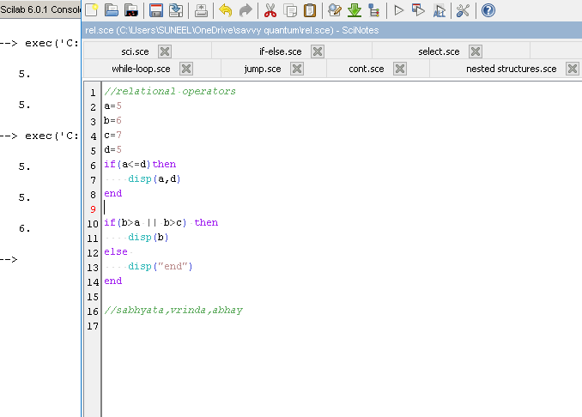
RELATIONAL OPERATORS

Slide 21
PRESENTATION By
SABHYATA
VRINDA
ABHAY
BSc(H.S) PHYSICS 3rd Semester

Slide 22

Acknowledgement
A sincere thanks to Dr. Lokesh Kumar for his guidance and supervision
All the classmates with whom we learnt the basics of SCILAB
Department of Physics Panjab university ,where we are able to learn the skills of computer programming

